Slide 1

Exercise 4.2 Plots
Shaquiel Pashtunyar
DSC640 Week 7/8

Slide 2
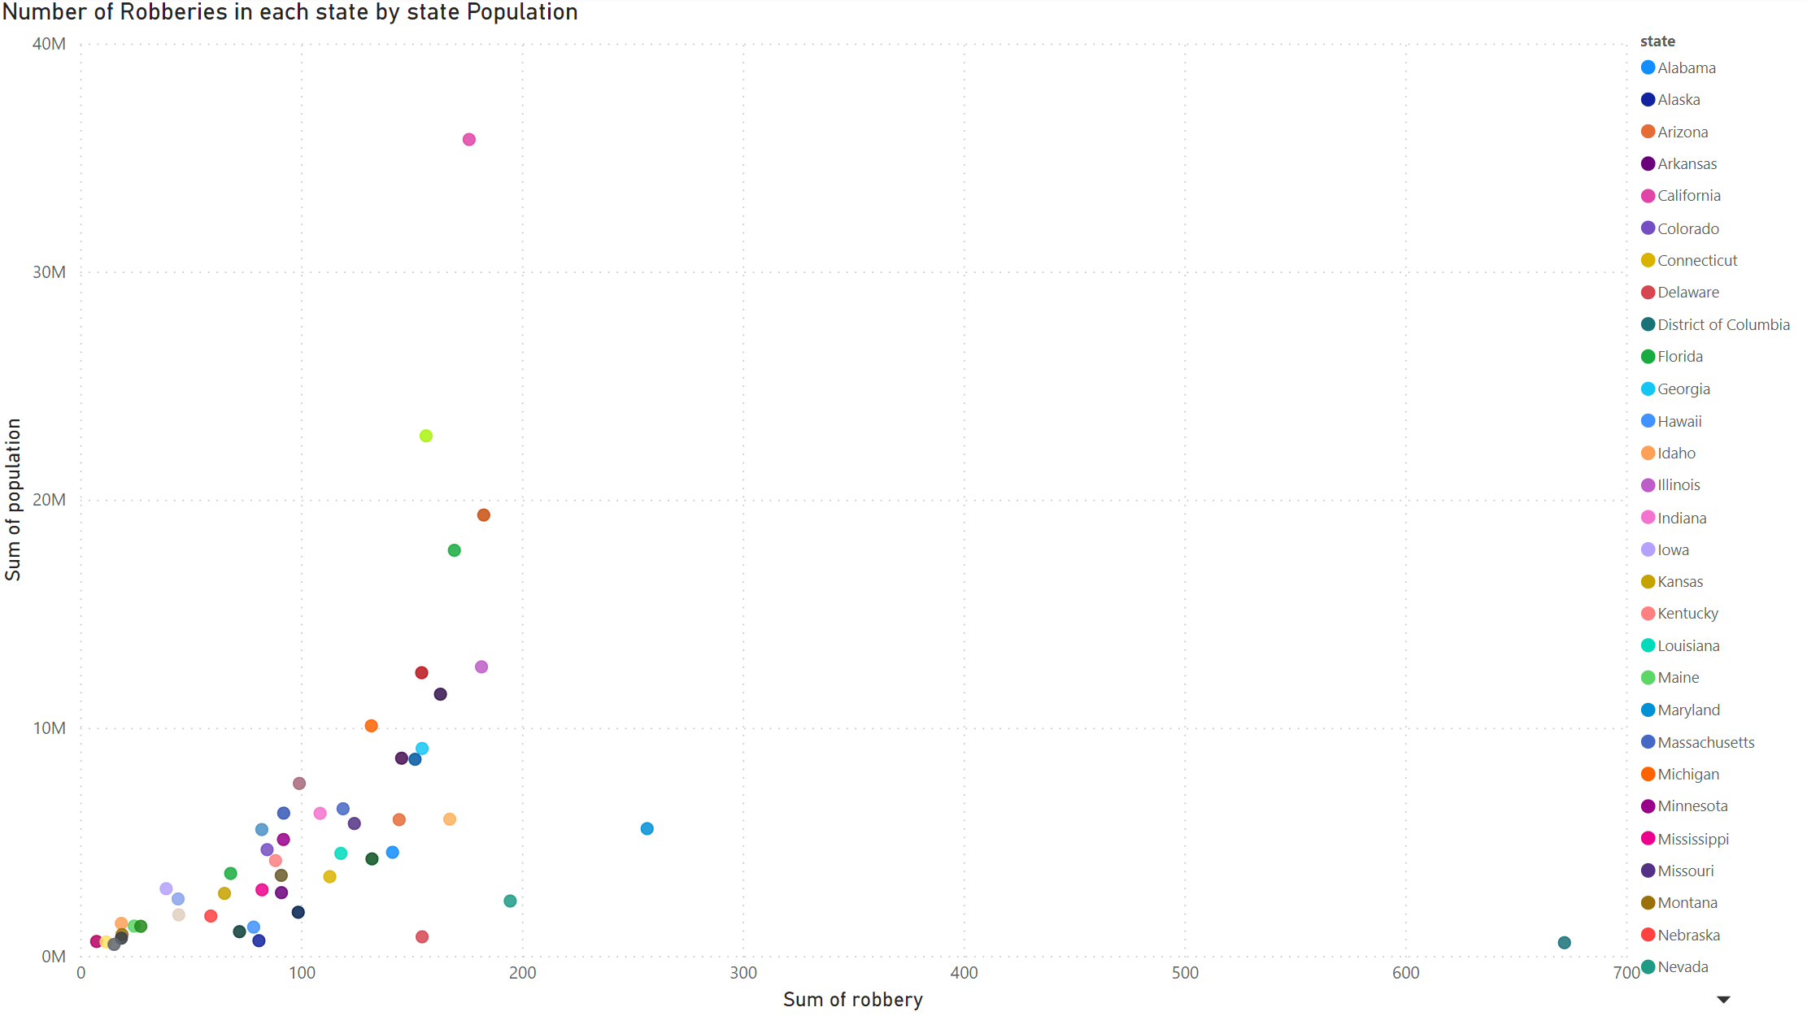
Power BI Scatter Plot

Slide 3
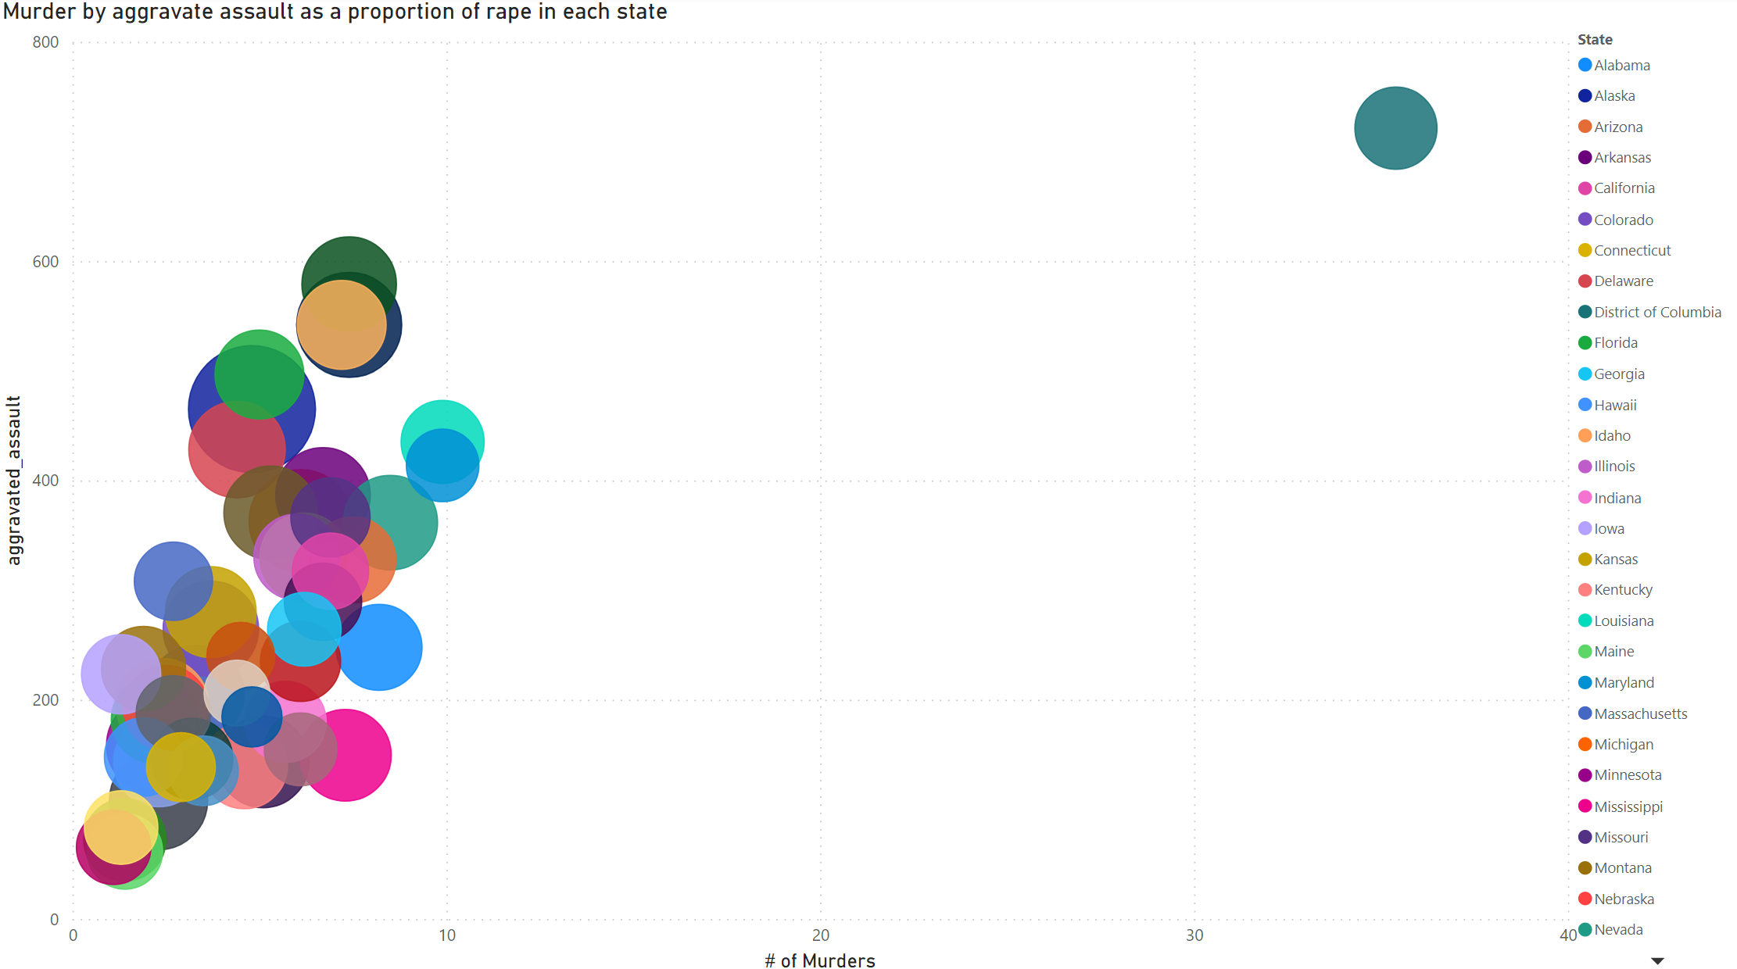
Power BI Bubble Chart

Slide 4
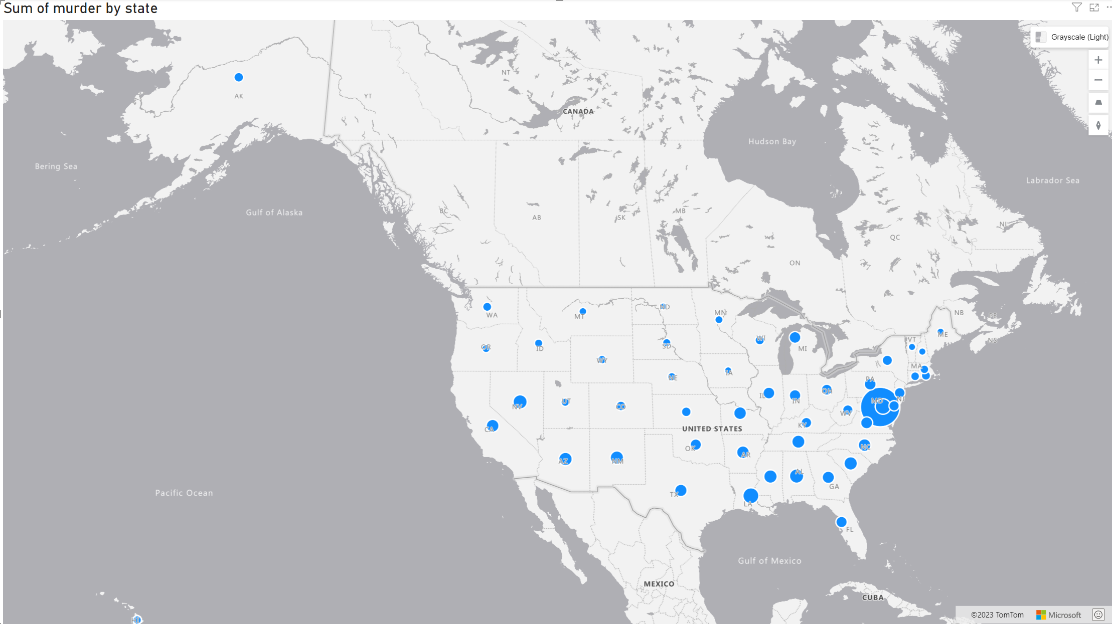
PowerBI Map Density

Slide 5
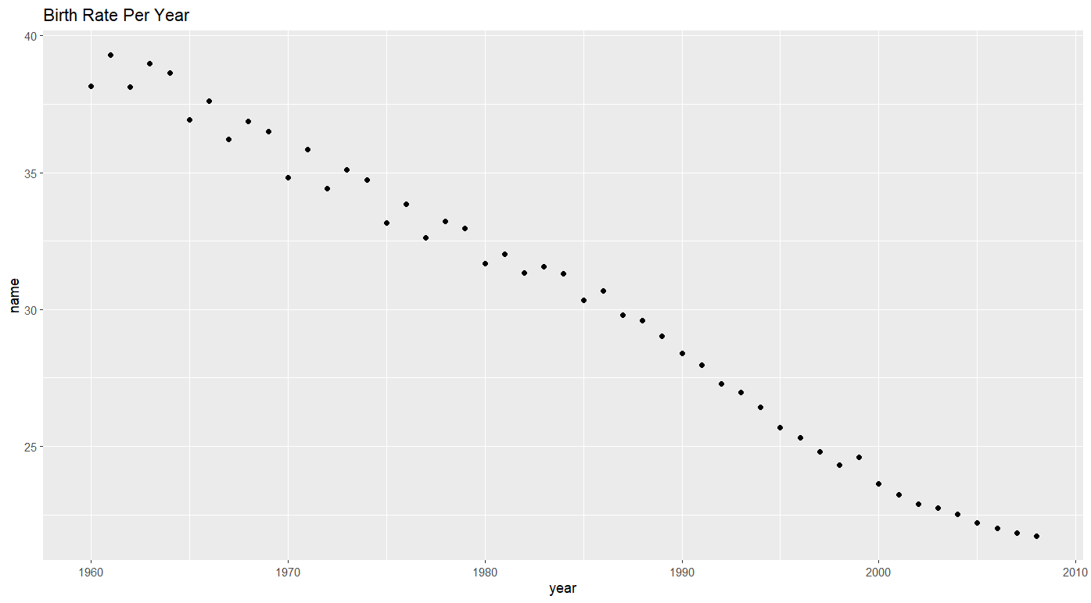
R Scatter Plot
ggplot(Groups, aes(x=year, y=name)) + geom_point() + ggtitle("Birth Rate Per Year")

Slide 6
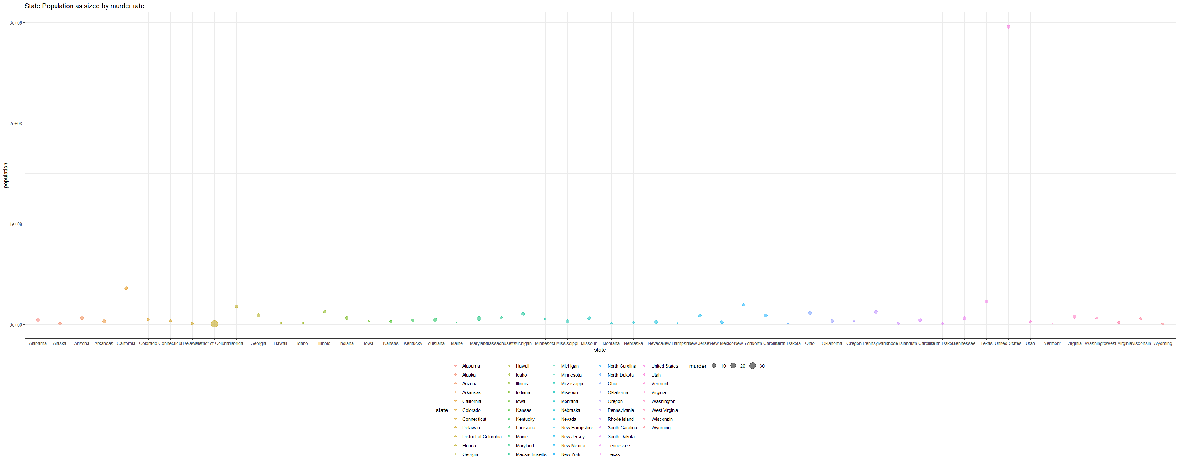
R Bubble Chart
ggplot(Crime, aes(x = state, y = population)) + geom_point(aes(color = state, size = murder), alpha = 0.5) + ggtitle("State Population as sized by murder rate")

Slide 7
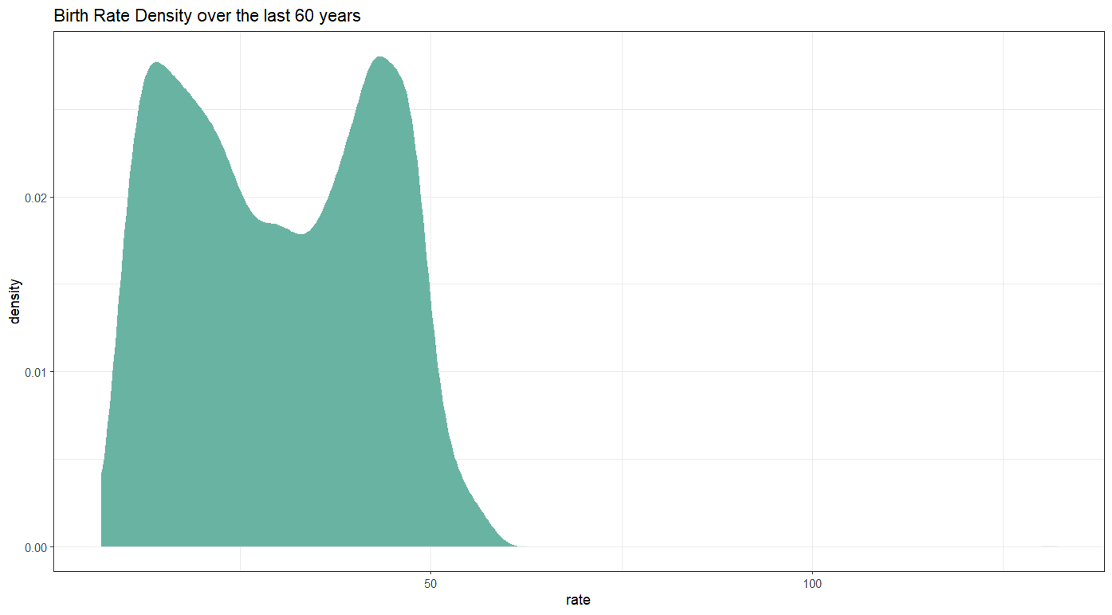
R Density Plot
ggplot(BirthYear_DF, aes(x=rate)) +geom_density(fill="#69b3a2", color="#e9ecef", alpha=1) + ggtitle("Birth Rate Density over the last 60 years")

Slide 8
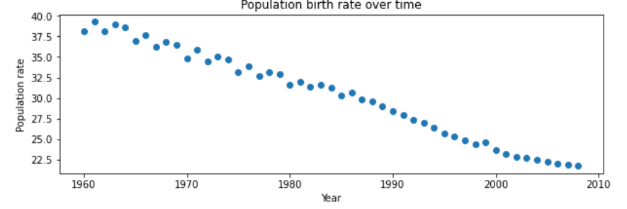
Python Scatterplot
plt.scatter(birth['year'].unique(),birth.groupby('year')[['rate']].mean())
plt.title('Population birth rate over time')
plt.xlabel('Year')
plt.ylabel('Population rate')
plt.show()

Slide 9
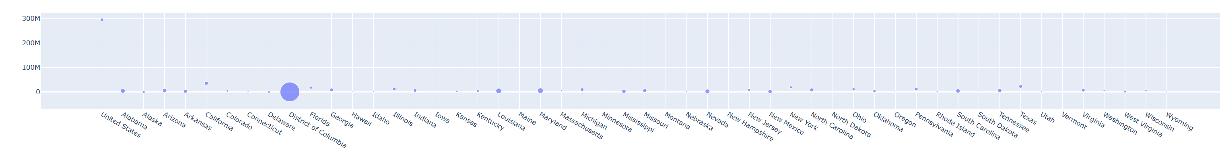
Python bUBBLE cHART
fig = go.Figure(data=[go.Scatter(
x=Crime["state"], y=Crime["population"],
mode='markers',
marker_size=Crime["murder"])])
fig.show()

Slide 10
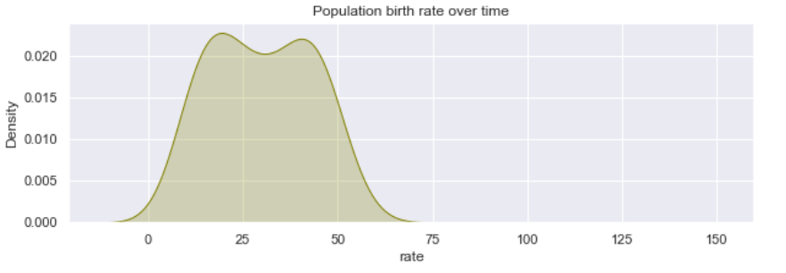
Python Density Plot
sns.kdeplot(birth['rate'], shade=True, bw=0.5, color="olive")
plt.title('Population birth rate over time')
plt.show()

